Slide 1
Advanced Survival Analysis Part #2
Dr Oliver Perra
Full resource: https://www.ncrm.ac.uk/resources/online/all/?id=20860

Slide 2
Outline: Survival Analysis – Continuous Time
Include predictors of event occurrence
Modelling effects of predictors
Introducing the Cox regression model

Slide 3
Recap
Continuous time is broken into small intervals that approach (but do not reach) zero
This allows to estimate j interval functions:
Survivor function (probability of surviving past interval j);
Hazard function (rate of event probability in interval j);
Cumulative hazard function (cumulates hazard from start of study to interval j):
Nelson-Aalen method; Negative log of survivor function.

Slide 4
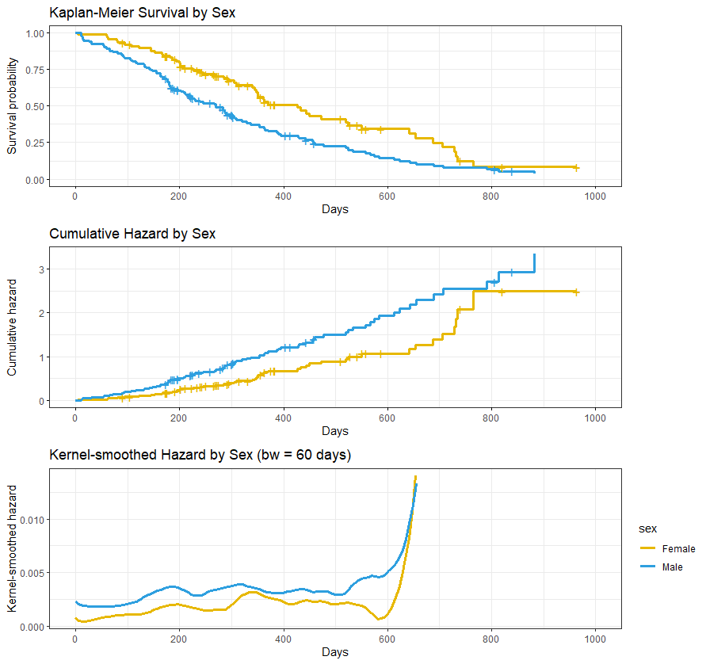
Including Predictors
Lung cancer dataset (“survival” R library):
Variable “sex”→ dummy-coded as “male”
Notes:
I will keep using the lung cancer dataset to provide an example of how we can include predictors in Survival Analysis in a continuous time metric. In the introduction to survival analysis for NCRM I had provided examples where predictors were included in analyses of events measured in a discrete time metric, but the principles are analogous.
Here I will consider a categorical predictor, sex, dummy coded as male.
We can start by exploring the Kaplan-Meier survivor function, cumulative hazard function using the Nelson-Aalen method, and the kernel-smoothed hazard function. Please refer to the R scripts included with these resources, which illustrate how I conducted these analyses and created these graphs. You realise that the kernel-smoothed hazard do not cover the full range of event times.
You can see the graphs suggest that male patients have lower probability of survival across most of the study period. The cumulative hazard function suggests acceleration around the first year anniversary (365 days). We can also note the rise in the right end of the graph, but we need to be careful with these because the estimates are based on a much smaller risk set.
Given the complexity of these estimates, it may seem difficult to build a statistical model of the association between covariates and event occurrence.

Slide 5
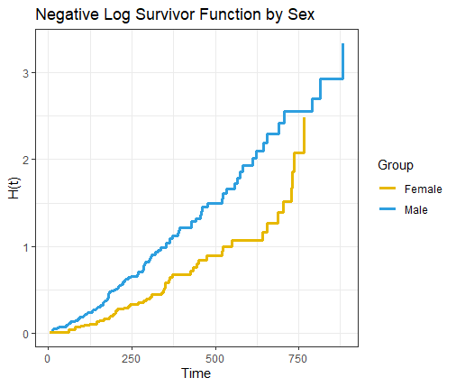
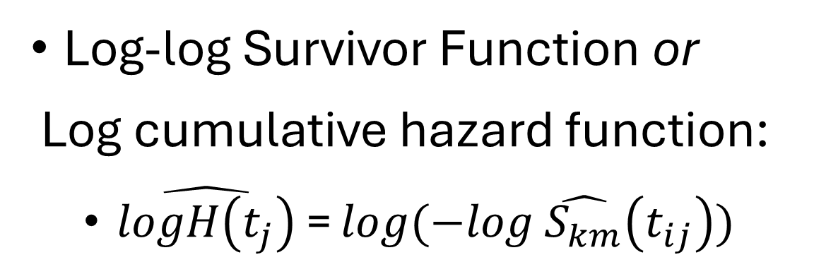

Building a Statistical Model with Predictors
Cumulative Hazard Function
Negative Log Survivor Function:
$\hat{H_{−LS}}\left(t_{j}\right)$ = $−log \hat{S_{km}}\left(t_{ij}\right)$
Log-log Survivor Function or
Log cumulative hazard function:
$\hat{logH\left(t_{j}\right)}$ = $log(−log \hat{S_{km}}\left(t_{ij}\right))$
Notes:
A common strategy to build a statistical model is to start with the cumulative hazard functions, and we can consider the formula that estimates these based on the negative log of the survivor function. I put here their formula, which I introduced in the previous presentation. This estimate capitalises on the relationship between hazard and survival, and estimates the cumulative hazard function between the start of the study and interval tj as the negative log of the survivor function of that interval.
The problem with these estimates is their semi-bounded nature: they are bounded from below by zero, so they cannot be negative, but there is no bound above.
In order to deal with this, we can use the log of the negative log: the advantage of doing this is that this yields an unbounded function that can range between –infinite and +infinite. This is often called the “log-log survivor function”, but it can take other names as the “log negative log survivor function”.

Slide 6
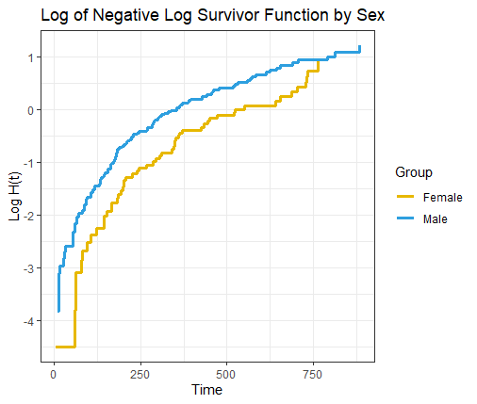
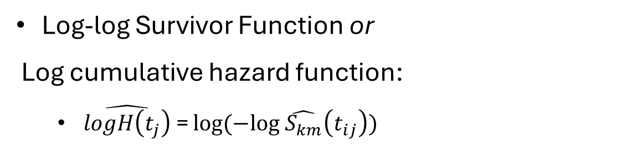
Building a Statistical Model with Predictors
Log-log Survivor Function or
Log cumulative hazard function:
$\hat{logH\left(t_{j}\right)}$ = $log(−log \hat{S_{km}}\left(t_{ij}\right))$
Notes:
Here I show how the log of the negative log survivor function transforms the distribution. On the left you see the negative log survivor, but on the right you can see the log log survivor function. Note that the negative values in the latter only indicate cumulative hazard that is less than 1. As all log transformations, the result of the transformation is to change the magnitude of difference between values: the distance between small values is expanded in the log transformed distribution, and the distances between large values become more compressed.
This is particularly useful here because it allows to highlight between-group differences in the early stages of the study, which tend to be more precise because the risk set is larger, and diminishes between-group differences in the later values, which tend to be more erratic.

Slide 7
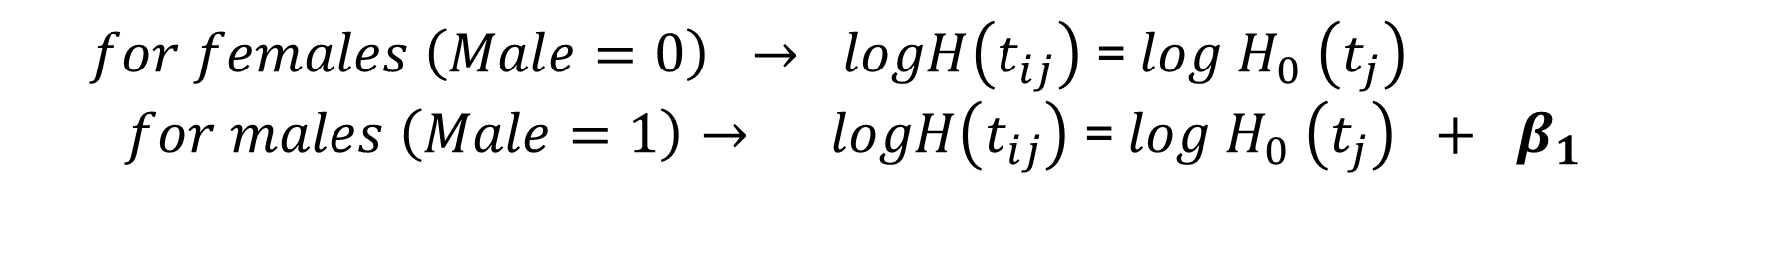
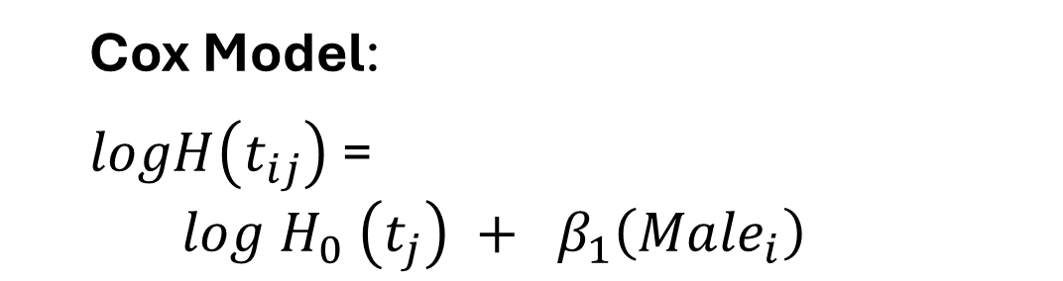
Building a Statistical Model with Predictors
Log cumulative hazard function
Cox Model:
$logH\left(t_{ij}\right)$=
$$log H_{0} \left(t_{j}\right) + β_{1}\left({Male}_{i}\right)$$
$for females \left(Male=0\right) → logH\left(t_{ij}\right)$= $log H_{0} \left(t_{j}\right)$
$$for males \left(Male=1\right)→ logH\left(t_{ij}\right) \text{= }log H_{0} \left(t_{j}\right) + β_{1}$$
Notes:
Now we need to develop a model that can represent the relationship between the log cumulative hazard function and the predictors.
As in the discrete time example I presented in the introductory resources for NCRM, the strategy is to express the log cumulative hazard function as the sum of a baseline function and a weighted linear combination of predictors, in this case male. This is the Cox model, based on a seminal paper written in 1972.
Here capital H0 indicates the cumulative hazard function when all predictors in the model are equal to 0. In this example, it will b e the cumulative hazard function for females.
In the bottom of the slide I partitioned the model for females and males. This illustrates that once we estimate the log cumulative hazard function of females, the log cumulative hazard function of males will be based on that of females, but it will just shift vertically, and the size and direction of this shift will be determined by the value of the beta 1 parameter.
Since we only have a single value of beta, here we are assuming that the effect of being male, the vertical shift associated with being male, is constant over time.

Slide 8
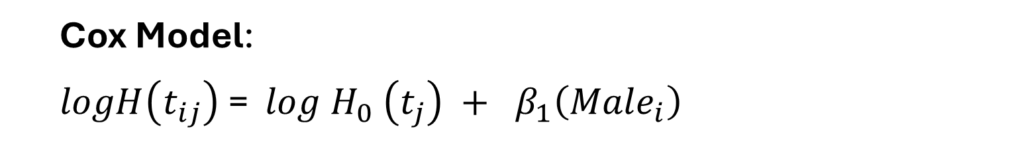
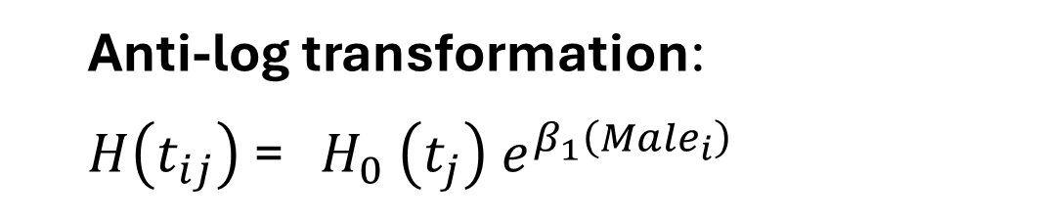
Cox Model
Log cumulative hazard function
Cox Model:
$logH\left(t_{ij}\right)$= $log H_{0} \left(t_{j}\right) + β_{1}\left({Male}_{i}\right)$
Anti-log transformation:
$H\left(t_{ij}\right)$= $H_{0} \left(t_{j}\right) e^{β_{1}\left({Male}_{i}\right)}$
Cumulative Hazard Function
Notes:
Before we move on, it is important to highlight something here: Given the Cox model, we can take the antilog of the terms on both sides, and write the model to express the cumulative hazard function (Ht):
So, this should highlight that when we model the log cumulative hazard function, we are assuming a linear relationship between the estimated outcome and the predictors: the effect of male will be constant and its magnitude is represented by the beta parameter.
But when we express the model as cumulative hazard functions, the effect of male is non linear, since it involves exponentiation of the Euler’s number and multiplication. The result is that when we consider the hypothetical cumulative hazard functions for males and females postulated by the model, these cumulative hazard functions will not be equidistant.

Slide 9
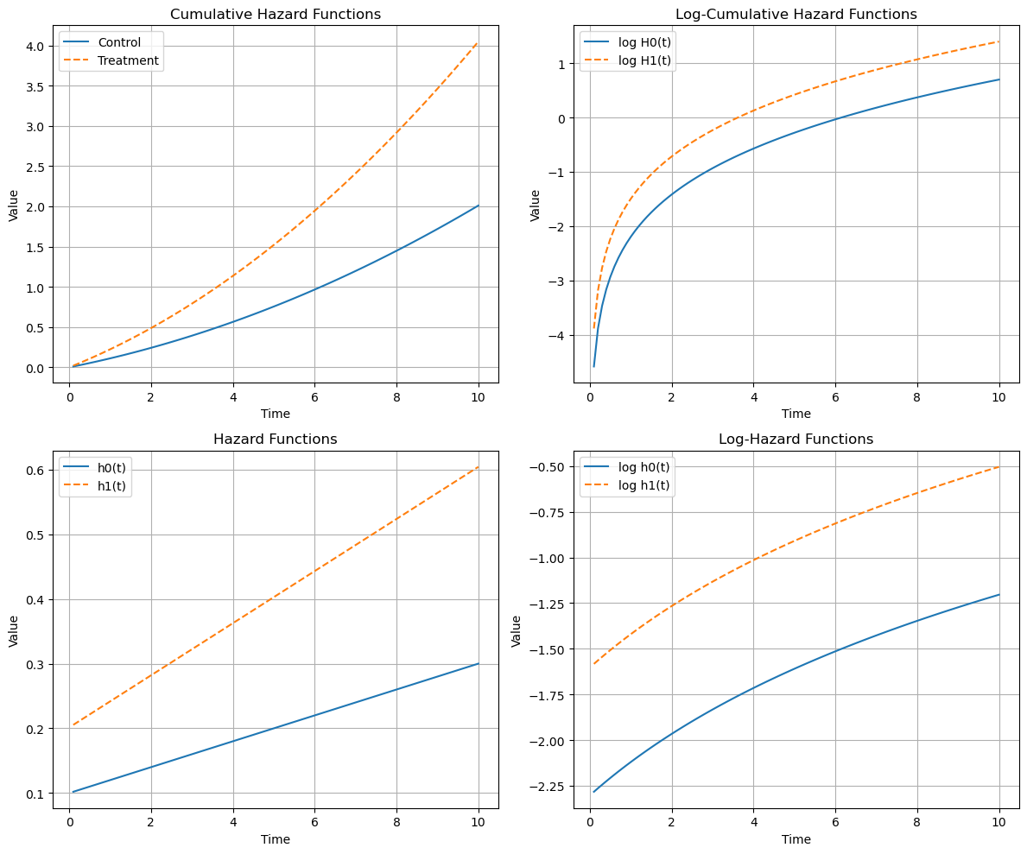

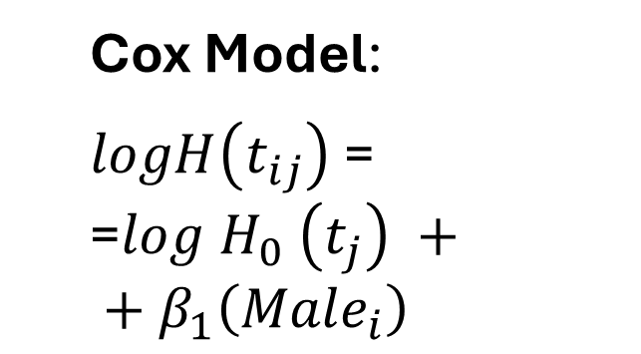
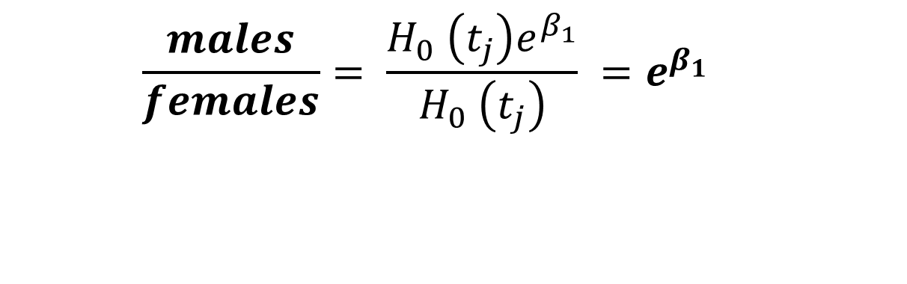
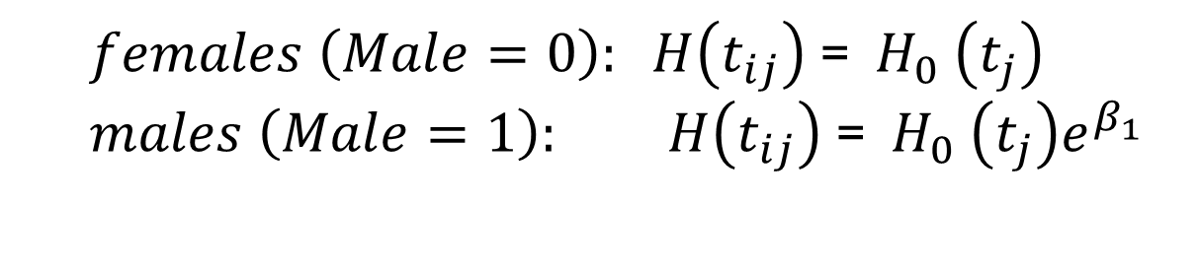

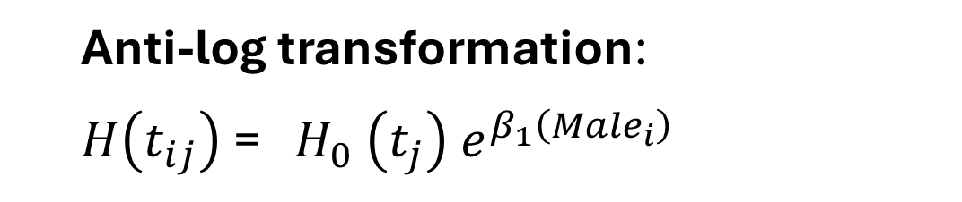

Effect of Predictor is Constant Over Time
Cox Model:
$logH\left(t_{ij}\right)$= =$log H_{0} \left(t_{j}\right) + + β_{1}\left({Male}_{i}\right)$
$$β_{1}$$
$$β_{1}$$
$$e^{β_{1}}$$
Anti-log transformation:
$H\left(t_{ij}\right)$= $H_{0} \left(t_{j}\right) e^{β_{1}\left({Male}_{i}\right)}$
$females \left(Male=0\right): H\left(t_{ij}\right)$= $H_{0} \left(t_{j}\right)$
$$males \left(Male=1\right): H\left(t_{ij}\right) \text{= } H_{0} \left(t_{j}\right)e^{β_{1}}$$
$$\frac{males}{females}= \frac{H_{0} \left(t_{j}\right)e^{β_{1}}}{H_{0} \left(t_{j}\right)} =e^{β_{1}}$$
Notes:
Finally, it is important to highlight that the model assumes a constant effect of the predictor over time, even if the cumulative hazard functions derived from the model are not equidistant.
This is because, first of all, the model is based on the log cumulative hazard function you see on top of the slide. Even if we transform the estimates from log cumulative hazard cumulative hazard, the model has not changed and is based on assuming a constant effect of the predictor.
But the other reason to say the predictor’s effect is constant over time lies in the fact that when we consider the cumulative hazard function, the relative distance in the cumulative hazard functions will be identical over time, as I demonstrated here: If we take the ratio between the cumulative hazard function of males and that of females, the two H0 terms in the division cancel each other, so, the relative distance between the cumulative hazard functions of the two groups will be constant and equal to the exponentiation of the beta parameter. In both cases, the effect of the predictor is time constant.

Slide 10



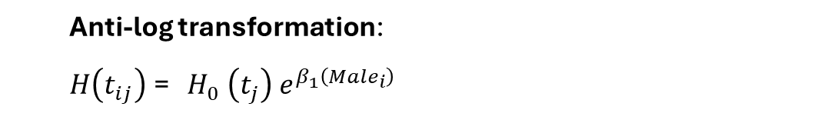

Cox Model
$$β_{1}$$
$logH\left(t_{ij}\right)$= $log H_{0} \left(t_{j}\right) + β_{1}\left({Male}_{i}\right)$
$$e^{β_{1}}$$
Anti-log transformation:
$H\left(t_{ij}\right)$= $H_{0} \left(t_{j}\right) e^{β_{1}\left({Male}_{i}\right)}$
$$β_{1}$$
$$e^{β_{1}}$$
Notes:
Another key property of the cox model is that, by capitalising on the mathematical links between the cumulative hazard and the hazard function, the model can be expressed directly in terms of hazard.
A demonstration of this property is too complex to go into details: the key point is that as the fitted log cumulative hazard functions of the two groups are separated by a constant absolute amount beta1, so are the fitted log hazard functions of the two groups, see the two simulated functions on the right panel. And as the predicted raw cumulative hazard functions of the two groups are separated by a constant relative amount equal to the exponentiation of beta1, so are the predicted raw hazard functions of the two groups, see the simulated functions on the left panel.
This means that the Cox model takes an identical form regardless of whether we express the outcome as cumulative hazard, or as raw hazard.
This provides another key advantage of the model, that is we an interpret the parameters of the Cox model in terms of how the predictor affects the hazard, and therefore gives us a more intuitive and informative metric to interpret the model than the cumulative hazard function.

Slide 11
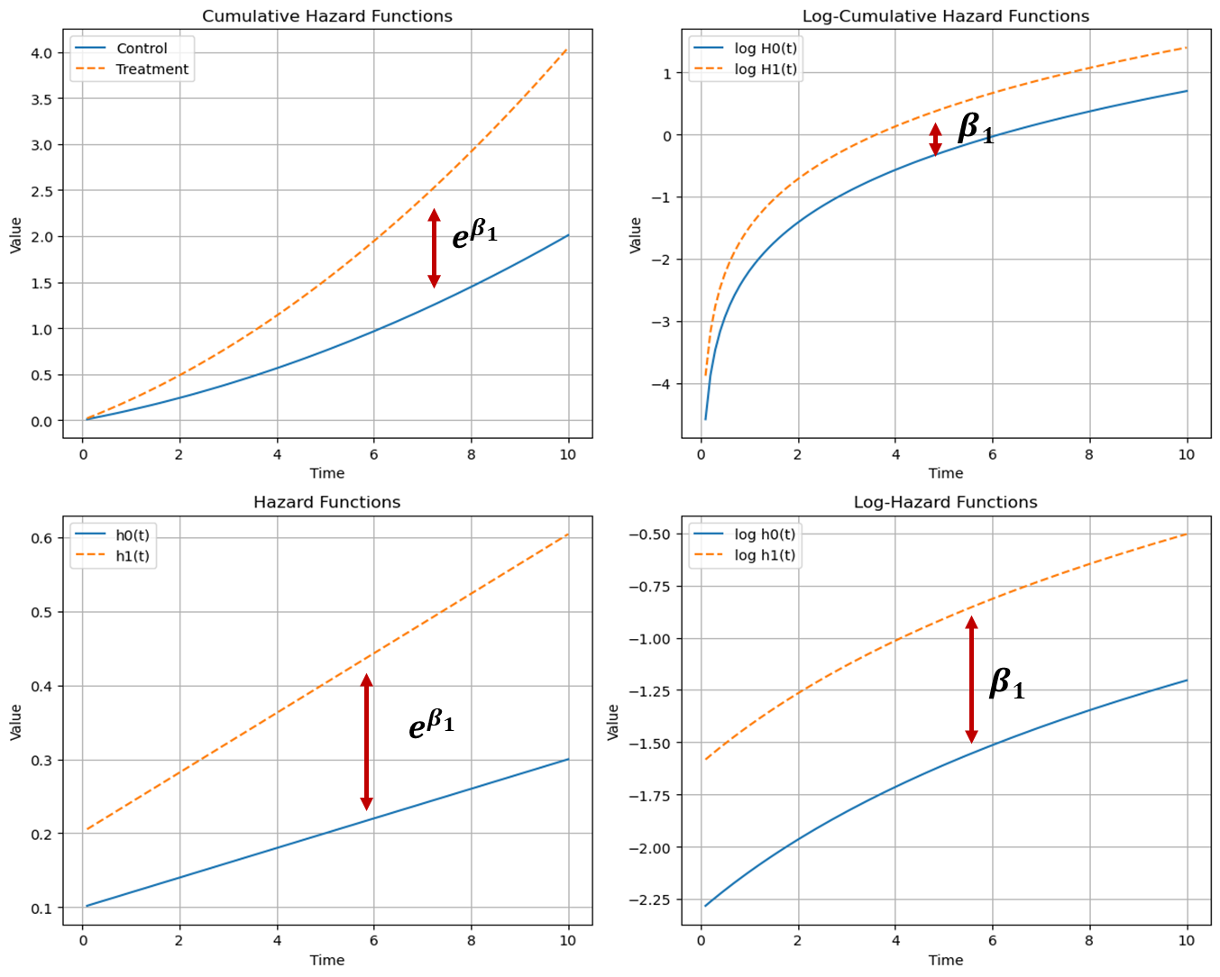
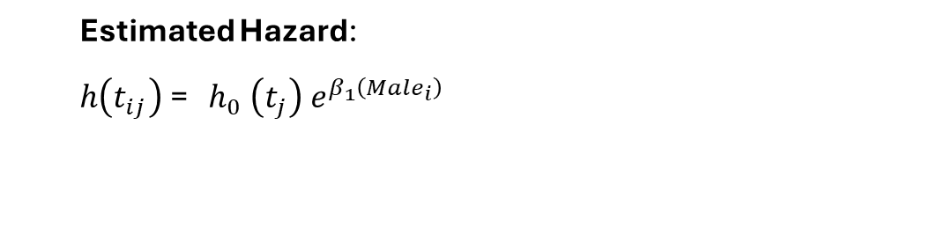
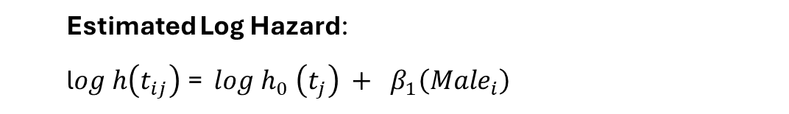
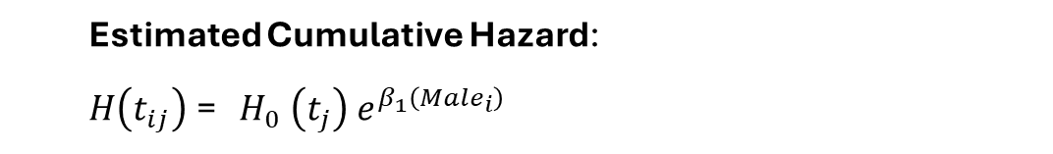
Cox Model
$logH\left(t_{ij}\right)$= $log H_{0} \left(t_{j}\right) + β_{1}\left({Male}_{i}\right)$
Estimated Cumulative Hazard:
$H\left(t_{ij}\right)$= $H_{0} \left(t_{j}\right) e^{β_{1}\left({Male}_{i}\right)}$
Estimated Log Hazard:
l$og h\left(t_{ij}\right)$= $log h_{0} \left(t_{j}\right) + β_{1}\left({Male}_{i}\right)$
Estimated Hazard:
$h\left(t_{ij}\right)$= $h_{0} \left(t_{j}\right) e^{β_{1}\left({Male}_{i}\right)}$
Assumption #1: There is a fitted log hazard function for each value of the predictor (whether categorical or continuous);
Assumption #2: Each of these fitted log hazard functions has an identical shape;
Assumption #3: The distance between each of these log hazard functions is identical at every possible interval.
Notes:
So, here I have written the Cox model estimated of the cumulative hazard, the estimated log hazard, and the estimated hazard. The log estimates of the different values of the predictors will have a constant absolute distance equal to the beta parameter, regardless whether they are the log of the cumulative or the interval hazard.
The estimates of the cumulative hazard or the hazard function for an interval will be separated by a constant relative amount equal to exponentiation of the beta coefficient.
These properties of the model can help highlight three key assumption:
There is a fitted log hazard function for each value of the predictor (whether categorical or continuous). When we have more than one predictors, we assume there are fitted log hazard functions for each combination of the predictor values.
Each of these fitted log hazard functions has an identical shape; So, in the example we were using, we assume that the log hazard functions of males and females lung cancer patients have the same shape. It does not matter what shape these functions have, but we assume that different levels of the predictors will be associated with fitted functions that have the same shape.
The distance between each of these log hazard functions is identical at every possible interval.
Like all assumptions, these may be adequate or not, and when they are not adequate or realistic, they can be relaxed.

Slide 12
Cox Model: Example on “lung” dataset
 | Coef. | Exp(coef.) | SE Coef. | z | p
Male | 0.53 | 1.70 | 0.17 | 3.18 | .001
Characteristic | HR | 95% CI | p-value
male | 1.70 | 1.23, 2.36 | 0.001
Abbreviations: CI = Confidence Interval, HR = Hazard Ratio
Notes:
Having introduced the Cox regression model, I show the results provided by fitting the model to the lung cancer dataset to explore the role of predictor male on event occurrence. The results indicate a significant effect of predictor male.
The coefficient is the log of the hazard function. By exponentiating we obtain the Hazard Ratio HR. This is ratio of hazard function between two groups at any particular point in time. So, this result indicates that at any point in time 1.70 more male patients are dying than female ones.
Note that we do not obtain an estimated baseline in the model, we just obtain an estimate for the beta parameter representing the change in the log hazard of event occurrence associated with a predictor. In the next presentation I will further discuss the implications of not estimating a baseline, but this is also a feature that makes the Cox model more flexible.

Slide 13
Cox Model: Adding a continuous predictor
$logH\left(t_{ij}\right)$= $log H_{0} \left(t_{j}\right) + β_{1}\left({Male}_{i}\right)+β_{2}\left({Age}_{i} −Mdn_age\right)$
 | Coef. | Exp(coef.) or HR | SE Coef. | z | p
Male | 0.51 | 1.67 | 0.17 | 3.07 | .002
Age (centred) | 0.02 | 1.02 | 0.01 | 1.85 | .065
Notes:
Here I provide a further example with a continuous predictor. The dataset included participants’ age at the start of the study. So, I have included age, centred at the median age (63), as a predictor. The model is described on the first line in the slide. The model includes an additional parameter beta2, which represents the change in the log cumulative hazard function associated with a 1-unit increase in age, while controlling for participants’ sex.
The results indicate that for a 1-year increase in participants’ age, the log cumulative hazard function increases by 0.02 units. The antilog returns a hazard ratio of 1.02. Namely, the hazard of dying is 2% higher for each year of patients’ age, while controlling for patients’ sex.

Slide 14
Summary
Cox Regression Model:
Estimates the log of the negative log survivor function (i.e.: log of the cumulative hazard function).
Mathematical relationships mean the model can be expressed in terms of estimated cumulative hazard and estimated raw hazard.
Key assumptions:
A fitted log hazard function for each value of the predictor;
Fitted log hazard functions have an identical shape;
The distance between log hazard functions is identical at every possible interval.

Slide 15
www.ncrm.ac.uk

